Slide 1
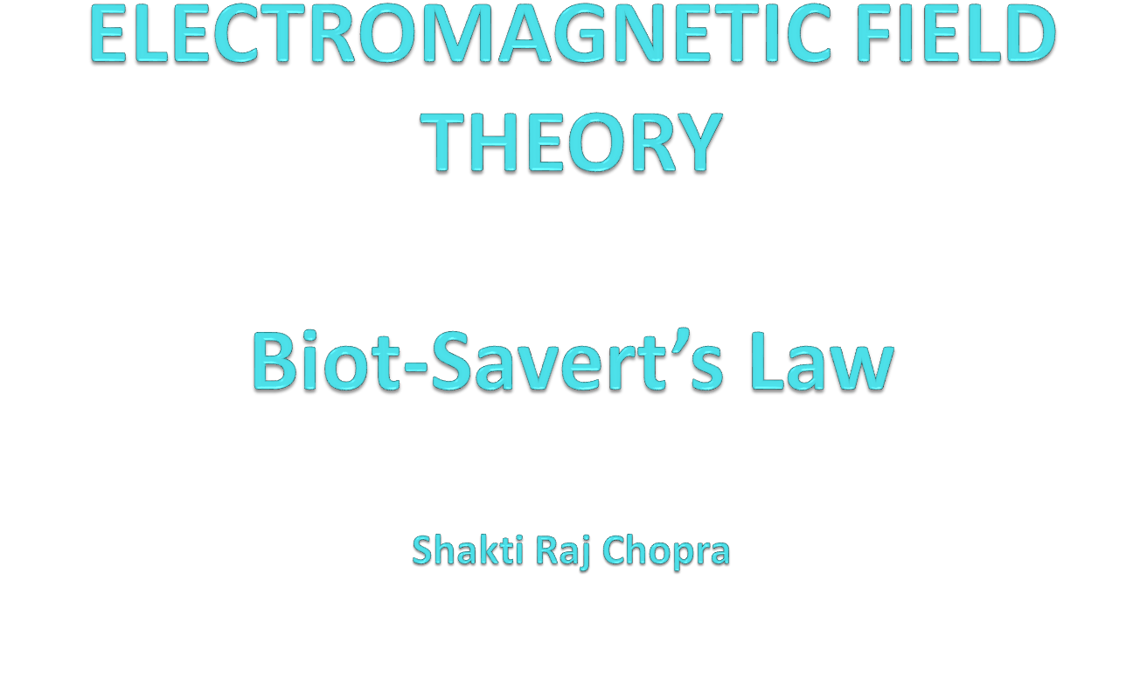

Slide 2
Books
Text Book:
1. PRINCIPLES OF ELECTROMAGNETICS
By - MATTHEW N.O. SADIKU, 4th 2009 OXFORD UNIVERSITY
PRESS, INDIA
Reference Book:
1. ELECTROMAGNETIC WAVES AND RADIATING SYSTEMS
By - EDWARD C. JORDAN 5th PRENTICE HALL

Slide 3
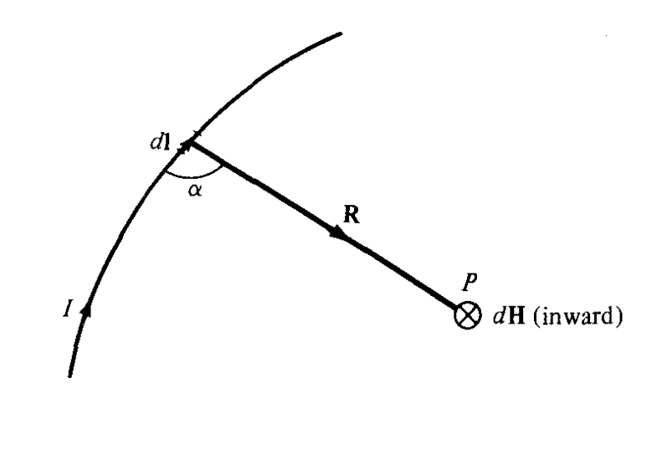
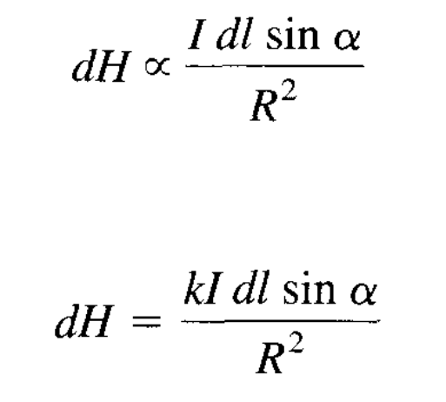
Biot-Savert’s Law
Biot-Savart's law states that the magnetic field intensity dH produced at a point P, by the differential current element Idl is proportional to the
product Idl and the sine of the angle α between the element and the line joining P to the element and is inversely proportional to the square of the distance R between P and the element.

Slide 4
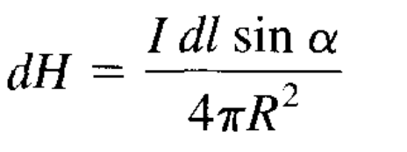
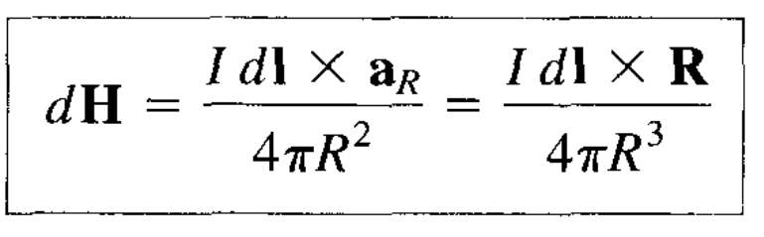
where k is the constant of proportionality. In SI units, k = l/4π, so eq. becomes
And

Slide 5
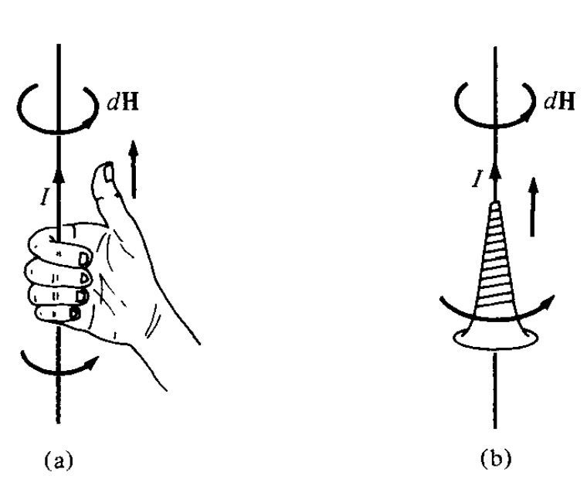
Determining the direction of dH using
(a) the right-hand rule, or (b) the right-handed screw rule

Slide 6
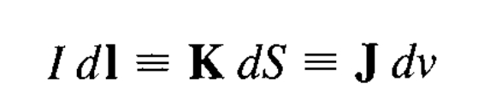
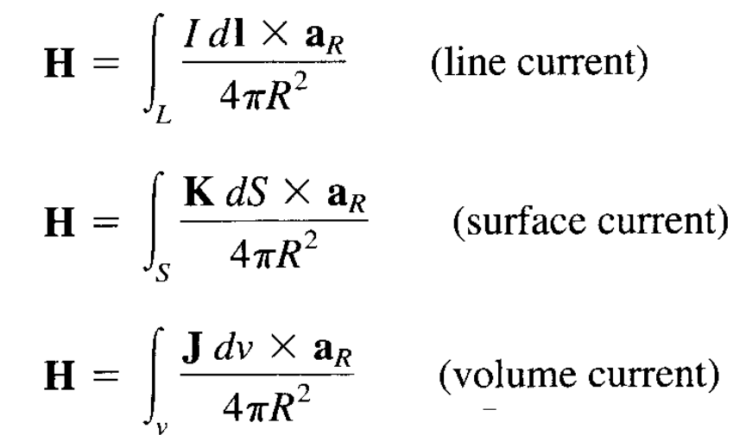
Surface and Volume Current Density
we define K as the surface current density (in amperes/meter) and J as the volume current density (in amperes/meter square), the source elements are related as
Thus in terms of the distributed current sources, the Biot-Savart law as in eq. becomes
:

Slide 7
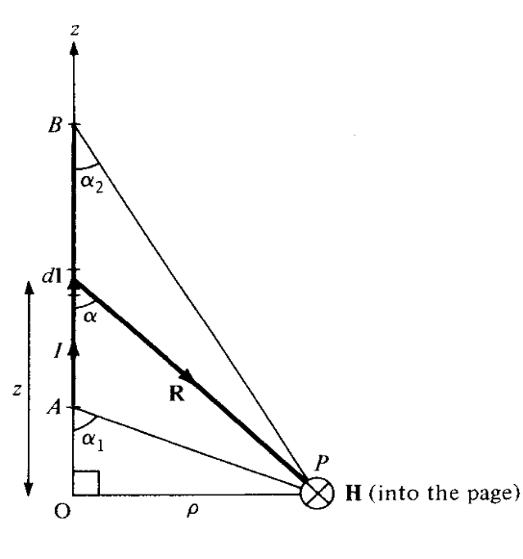
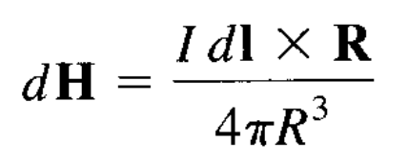


Application of Biot-Savert’s Law
let us apply Biot-Savert’s to determine the field due to a straight current carrying filamentary conductor of finite length AB as in Figure
Field at point P due to a straight filamentary conductor.
We assume that the conductor is along the z-axis with its upper and lower ends respectively subtending angles α1 and α2, at P due to an element dl at (0, 0, z),
:

Slide 8
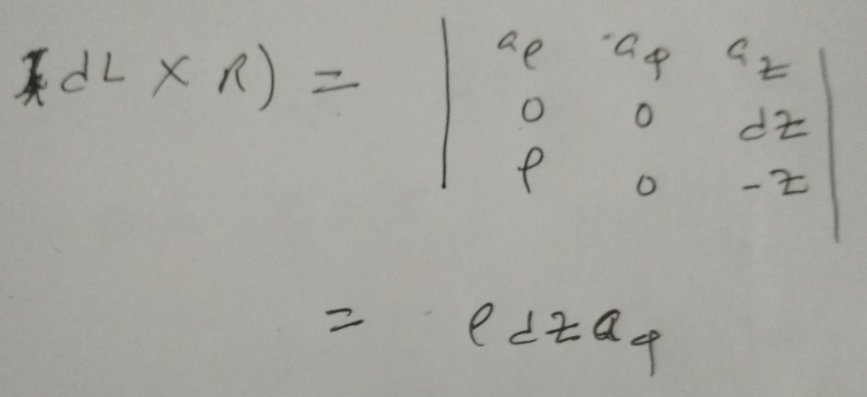
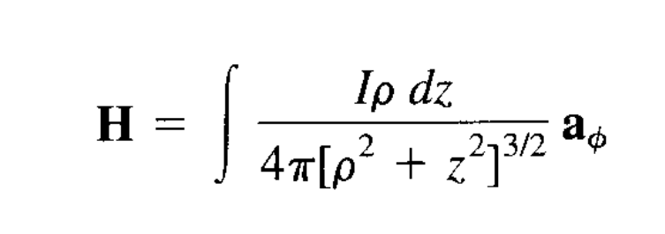
Hence
:

Slide 9
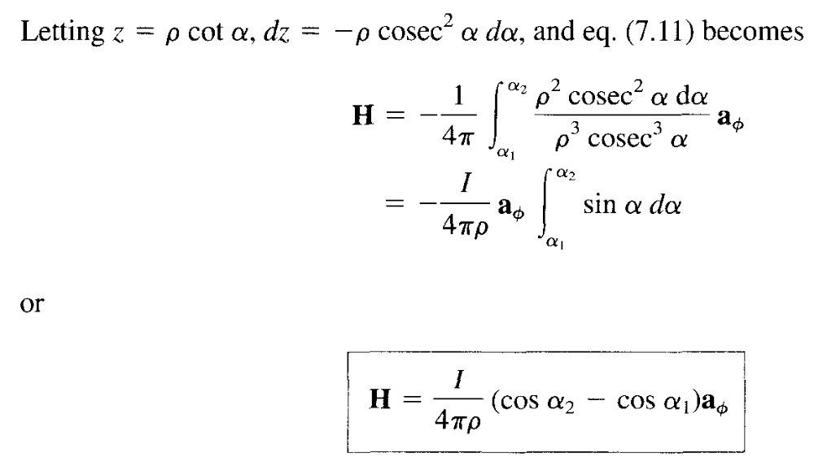
:

Slide 10
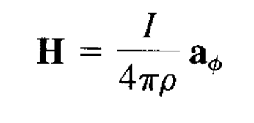
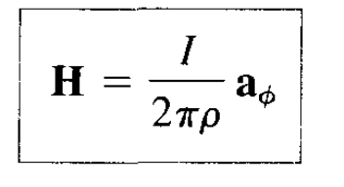
This expression is generally applicable for any straight filamentary conductor of finite length.
special case, when the conductor is semiinfinite (with respect to P) so that point A is now at
Another special case is when the conductor is infinite in length. For this case, point A is at

Slide 11
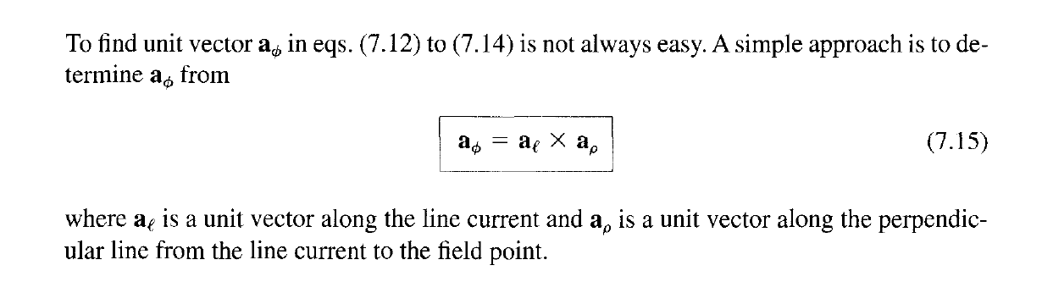
EXAMPLE
The conducting triangular loop in Figure 7.6(a) carries a current of 10 A. Find H at (0, 0, 5) due to side 1 of the loop.

Slide 12
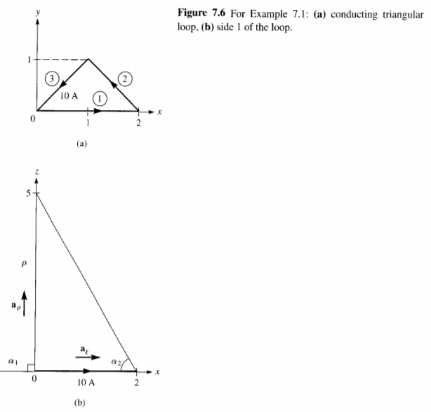

Slide 13
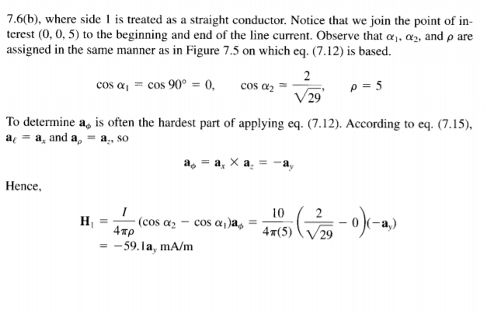

Slide 14
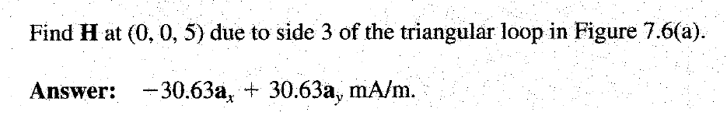
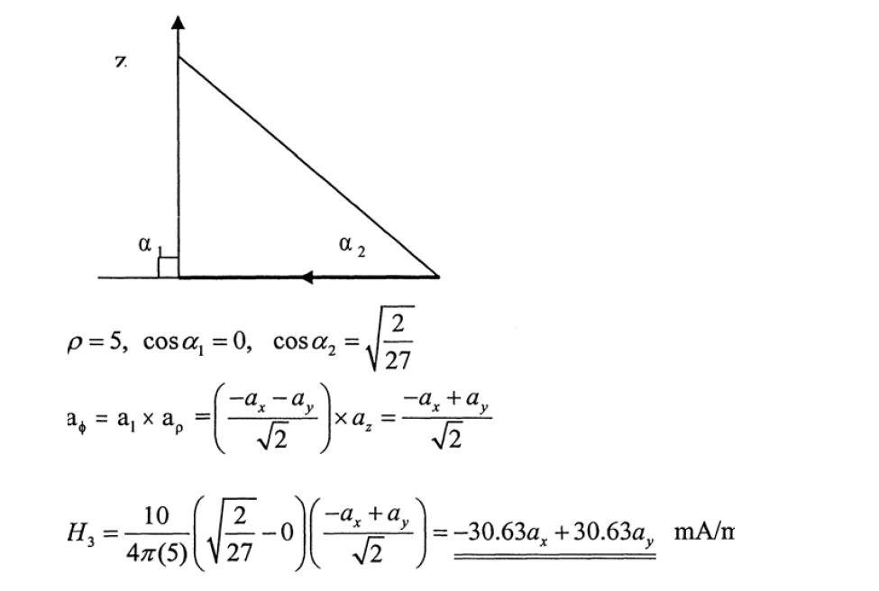

Slide 15


